Slide 1
COCIR workshop
Fostering Financial Sustainability of Healthcare Systems
20 June 2013, Warszawa
Outline of COCIR report
Hendrik Sobiszewski
COCIR Financial Sustainability Focus Group
Deputy Chair

Slide 2

European Healthcare Challenges
Rising expenditures
  rise in demand
  public health threats
  equal access to care
  Scarce resources
  staffing issues
  health spending cuts
  budgetary and fiscal pressure

Slide 3
Hospital of Today
Part of an integrated healthcare delivery system
Networking of primary and secondary care facilities
Connected and coordinated healthcare organisations place the patient at the heart of the healthcare process
Requires a major shift moving from acute care to the sick to supporting the health of the overall population
Changing landscape needs adaptation by using eHealth and healthcare technologies

Slide 4
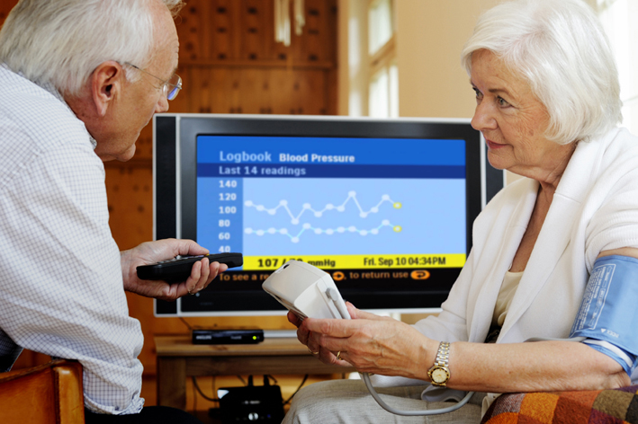
Medical technologies and eHealth
key for improving efficiency
Medical technologies:
Prevention
In-vitro diagnosis
Imaging
eHealth to connect people:
Enabler of change in social and health services delivery
Coherent vision of eHealth with short & long-term political goals
Targeting investments which facilitate integrated care will:
Improve the quality, productivity, safety, effectiveness and efficiency of healthcare delivery in the short-term,
Support a more sustainable high-quality healthcare services for more people at less cost.

Slide 5
Procurement process and availability
of healthcare technology
The technology must be ‘always available’
Need to optimise usage of technologies, incl. training, upgrades, patient workflow and processes
The traditional procurement process does not always guarantee the best usage of the technology

Slide 6

Healthcare transformation through
new business and financing models
Managed Services
Definition: The technical infrastructure made available against a fee and the contract is for a longer period of time
Characteristics:
  Capital asset and technology management plan
  continuous training and education
  integrator services
  workflow management
  R&D, hosting services
Benefits for the hospital: No capital up-front, simplified purchasing process, predictable operational costs, reduction of risk, state-of-the-art equipment, reduction of running costs, highly-trained staff

Slide 7

Healthcare transformation through
new business and financing models
Public Private Partnership
  Definition: A long-term (25-30 years) partnership between a public-sector authority, healthcare provider(s) and companies for modern, state-of-the-art healthcare infrastructure.
  Characteristics: Special Purpose Vehicle (SPV) constructed in which private companies take care of
  the whole hospital incl the buildings.
  Benefits for the hospital: Same as MS,
  but can have some other challenges.
  Managed Services and PPP models allow healthcare providers to renew their infrastructure at no, or much lower capital requirements, while reducing the risks of operations.

Slide 8
EU Cohesion Policy fund to support investment in healthcare
Current challenges:
Absorption in Member States progressing slower than expected
Lack of knowledge, resources & experts to prepare sound projects
Financial issues: co-financing requirement, lack of cash flow
Procurement procedures too lengthy and lacking transparency
Optimising utilisation:
Member States and their regions need to prioritise funding for healthcare under the 2014-2020 Cohesion Policy programme
Member States and their regions should be able to have access and share best practices from across Europe
The European Commission should create mechanisms facilitating an optimal use of the funds

Slide 9

4 key recommendations
Better use of healthcare and ICT technology and solutions
Managed Services and Public Private Partnerships should be considered in all Member States
Procurement criteria need to match the demand of the healthcare provider
The European Commission should ensure and facilitate, at national and regional level, the use of Cohesion Policy funds and encourage Managed Services and Public Private Partnership projects
Report available on www.cocir.org
Launch on 18 March 2013
in Brussels in presence of the Commissioner
Tonio Borg as a Keynote Speaker

Slide 10
COCIR collected key best practices

Slide 11
Investment Solutions
Deal Size
Complexity
PPP
Managed Service
Pay per Usage
Financing
Straight Sale/ CAPEX
Flexibility

Slide 12

Region Hovedstaden - Denmark
Category: Capital Investment and Managed Services
General overview and customer ambition:
  Region Hovedstaden, capital region of Denmark, started in 2011 the selection of a health ICT vendor
  Requirement: consolidate RIS/PACS environment across its 13 hospitals
Customer needs and key challenge:
  Use regional diagnostic resources in a more efficient way across the hospitals
Solution and benefits:
  Enable radiologists to have access to the patient’s complete history of radiology images and reports across the region
  Improve the quality of care and save costs
  Secure access to patients’ data for their patients
  Key figures:
  13 hospitals employing 36,000 staff and producing 1.6 million radiology examinations / year

Slide 13

Région Sans Film - France
Category: Managed Services
General overview and customer ambition:
  Initiative from French Ministry of Health in 2009 to deliver PACS and RIS health ICT applications to the Ile-de-France region
  Drive productivity and increase efficiencies through rapidly increasing usage of digital technology
  Customer needs and key challenge:
  Deliver PACS and the archiving of imaging services from the cloud as well as image distribution to the local general practitioners via the internet
  Solution and benefits:
  Increase in productivity
  Reduction of duplication, easier access to patients’ images
  Decrease of cost per exam
  Key figures:
  29 million euro project, 12 million inhabitants
  93 hospitals, 100+ private practices, 500+ radiologists

Slide 14
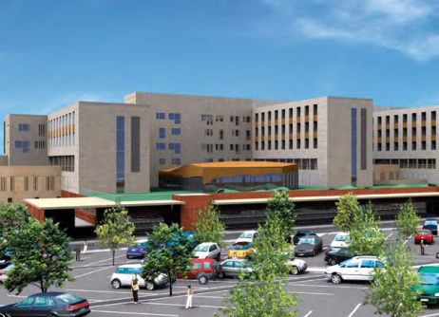
Murcia area - Spain
Category: Managed Services
General overview and customer ambition:
  15-year PPP contract to open 2 government-run hospitals in 2011
  Satisfy healthcare needs, equip hospitals with state-of-the-art medical technology, enhance quality of the state-funded healthcare sector
  Customer needs and key challenge:
  Remain competitive and be able to offer the best possible and cost-efficient treatment to patients
  Satisfy growing healthcare demand in a rural area
  Access to the latest imaging and lab technology and IT
  Solution and benefits:
  The industry provided the hospitals with 18,500 items including 100 imaging systems and set up the ICT and lab systems
  Financing and planning certainty, guarantee of innovations, quality enhancement, workflow consultancy, increased efficiency
  Key figures:
  2 hospitals, 656 and 329 beds

Slide 15
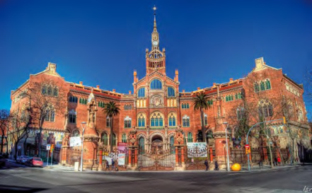
Hospital Sant Pau- Spain
Category: PPP and Managed Services
General overview and customer ambition:
  Project signed in 2009 in largest hospital in Spain (Barcelona)
  Be a world class healthcare provider and a renowned centre for treatment, research and education
  Customer needs and key challenge:
  Hospital moving to new building: fully equip it by moving existing equipment and incorporating new items
  Scale-up new imaging department
  Solution and benefits:
  A 10 year partnership beyond equipment: equipment in the imaging department, renewal of technology, procurement, capital asset plan, research collaboration, fixed monthly fee for total service
  Future proofing technology, transferring technology risk to the medical equipment provider, collaborative approach, performance guarantees
  Key figures:
  34,000 admissions, 150,000 emergency cases, 71 beds for day admission, 634 hospitalisation beds, 19 surgical rooms

Slide 16

Valencia Province - Spain
Category: Public Private Partnership
General overview and customer ambition:
  Patient Care Programme initiated 12 years ago by Valencia Province with a complete patient care system accessible to everyone at an affordable price
  Customer needs and key challenge:
  Patients had poor access to healthcare, long waiting times, long travel distance with high costs
  Solution and benefits:
  PPP model where providers are private investors for public healthcare
  No waiting time, screening programs, private rooms, home care, patient healthcare programmes
  Patient has free choice of healthcare provider
  Hospital quality management using latest e-health technology
  Key figures:
    Patient satisfaction rate >9, Costs per capita 600€ (2012)
    Average days of hospitalisation 4,2

Slide 17

Queen’s Hospital - UK
Category: Managed Services
General overview and customer ambition:
  Queen’s Hospital in Romford opened in 2006 and brought together the services previously run in two other hospitals
  Customer needs and key challenge:
  Ensure high quality medical equipment with high availabilities without using too many resources for management and procurement
  Solution and benefits:
  33-year vendor independent Managed Services agreement
  Transferring risk to the provider
  Right equipment, right time: more flexibility in using latest technology when needed
  Key figures:
  700,000 inhabitants, 939 beds

Slide 18

Royal Victoria Hospital - UK
Category: Managed Services
General overview and customer ambition:
  Biggest hospital complex in Northern Ireland signed a project in 2006 to improve health and wellbeing and reduce health inequalities
  Customer needs and key challenge:
  10-12 years plan of redevelopment including creation of a new imaging centre
  Solution and benefits:
  15-year multi-vendor partnership that goes beyond equipment
  Future proofing technology, transfer technology risk to provider, guarantee performance, service management, profit sharing, asset management, consultancy, education
  Key figures:
  4 hospitals, 7,000 staff
  80,000 admissions, 350,000 outpatients, 40 emergency/intensive care beds, 500 day hospital beds, 15 surgical rooms

Slide 19
Conclusion
All these models have their mutual target:
  Improve the quality, productivity, safety, effectiveness and efficiency of healthcare delivery in the short-term,
  Support a more sustainable high-quality healthcare services for more people at less cost.

